Slide 1
J0556 IBM Cloud and Cognitive Software Fast Start 2020 Using Discovery 2.1 for Expert Assist and Content Mining Angel Montesdeoca Offering Manager Watson Discovery John Pecorari Offering Manager Watson Discovery
#FastStart2020

Slide 2
Legal Disclaimer
© IBM Corporation 2020. All Rights Reserved.
The information contained in this publication is provided for informational purposes only. While efforts were made to verify the completeness and accuracy of the information contained in this publication, it is provided AS IS without warranty of any kind, express or implied. In addition, this information is based on IBM’s current product plans and strategy, which are subject to change by IBM without notice. IBM shall not be responsible for any damages arising out of the use of, or otherwise related to, this publication or any other materials. Nothing contained in this publication is intended to, nor shall have the effect of, creating any warranties or representations from IBM or its suppliers or licensors, or altering the terms and conditions of the applicable license agreement governing the use of IBM software.
References in this presentation to IBM products, programs, or services do not imply that they will be available in all countries in which IBM operates. Product release dates and/or capabilities referenced in this presentation may change at any time at IBM’s sole discretion based on market opportunities or other factors, and are not intended to be a commitment to future product or feature availability in any way. Nothing contained in these materials is intended to, nor shall have the effect of, stating or implying that any activities undertaken by you will result in any specific sales, revenue growth or other results.
Performance is based on measurements and projections using standard IBM benchmarks in a controlled environment. The actual throughput or performance that any user will experience will vary depending upon many factors, including considerations such as the amount of multiprogramming in the user's job stream, the I/O configuration, the storage configuration, and the workload processed. Therefore, no assurance can be given that an individual user will achieve results similar to those stated here.
All customer examples described are presented as illustrations of how those customers have used IBM products and the results they may have achieved. Actual environmental costs and performance characteristics may vary by customer.
IBM Cloud and Cognitive Software Fast Start 2020

Slide 3






You are Here: how this session fits in the AI Ladder story
Watson Discovery 2.1 for Expert Assist
Interact with Pre-built AI Services
Watson Application Services
Build
Deploy
Catalog
Manage
The Ladder to AI
Watson Machine Learning
Watson
Knowledge
Catalog
Watson
Studio
Watson OpenScale
Infuse
Analyze
Organize
AI Open Source Frameworks
Collect
Unlock the value of your data and accelerate your journey to AI
Unify on a Multicloud Data Platform
IBM Cloud Pak for Data
A one of a kind, pre-integrated set of data and AI services
delivered within an open and extensive cloud native platform
Cloud-native container platform and operational services
IBM Cloud
AWS
MS Azure
Google Cloud
Edge
Private
Hyperconverged
Private Cloud System
IBM Cloud and Cognitive Software Fast Start 2020

Slide 4
Technical Sales: Watson Discovery 2.1 for Expert Assist
Session Details and Activation
Session 1: Brief Overview, Methodology & Best Practices, New differentiating features, Client examples, Roadmap
Squad Name
Detailed Content Link
Cloud Pak for Data – Analyze and Infuse – AI
Customer: https://w3.ibm.com/w3publisher/expert-assist
Session Abstract
Session Goal
Learn how to design, implement, configure, and deliver the Expert Assist and Content Mining pattern, including best practices.
Position Watson Discovery to help SMEs reduce the time spent searching for insights from complex business documents
Build Expert Assist and Content Mining solutions with AI-powered search capabilities using Watson Discovery.
Why in Fast Start
The Watson Key Patterns are what IBM wants sellers & partners to focus on in 2020. Tech sales must support both.
DTE / Solution Tutorial Assets
https://www.ibm.com/demos/collection/Watson-Discovery/
Watson Discovery for Expert Assist demo
Content Creator
John Pecorari and Angel Montesdeoca
SMARTER Skill(s) to improve
Discovery Foundations. Expert Assist & Discovery Methodology courses are being created.
IBM Cloud and Cognitive Software Fast Start 2020

Slide 5
Session Agenda
Introduction to Session​
What is “Expert Assist”?
Why Watson Discovery for Expert Assist?
Demos and What’s New
Roadmap
What About WEX?
Pricing and Sizing
Additional Resources​ / FAQ
Q&A
IBM Cloud and Cognitive Software Fast Start 2020

Slide 6
Introduction to Session
Expected Outcomes
Understand the Expert Assist Use-Cases
Learn referenceable client examples
Learn how to demo Discovery Expert Assist Capabilities
Understand how Discovery is different
Understand how to price and size a deployment
Get any remaining questions answered
IBM Cloud and Cognitive Software Fast Start 2020

Slide 7
What is Expert Assist?

Slide 8
Watson for Expert Assist
Reduce amount of time experts search for information
Support better decision making
Empower experts with instant access to critical information with the leading AI powered search platform.
Bring expertise to everyone
Train Faster and Smarter with Watson
IBM Cloud and Cognitive Software Fast Start 2020

Slide 9


Characteristics of Expert Assist
Complex or large quantities of data
Low utilization of data
Expert user with information need
IBM Cloud and Cognitive Software Fast Start 2020

Slide 10
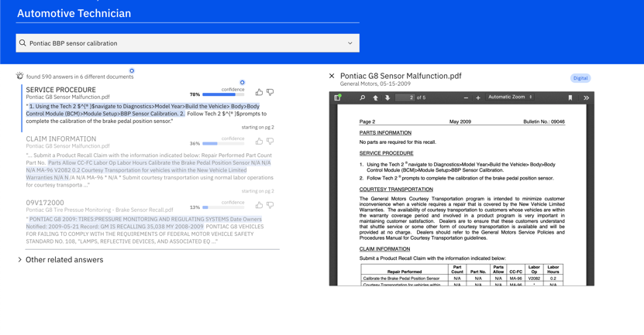
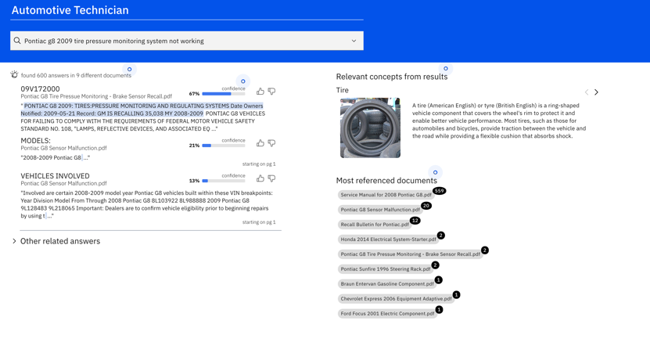
ROI of Expert Assist
Significant savings of time and efficiency for high skill experts
35% reduction in time spent per day * 120 min on research * $300/hr * 10 experts = ~$750,000/year
Access to information previously unavailable or inaccessible provide new revenue opportunities
10% increase in likelihood of new opportunity * 80 opportunities per year * $500K per opportunity = ~$4,000,000/year in potential growth
IBM Cloud and Cognitive Software Fast Start 2020

Slide 11


Empowering the Expert
Field tech
Market analyst
Project engineer
Risk advisor
Financial analyst
IBM Cloud and Cognitive Software Fast Start 2020

Slide 12
Why Discovery?

Slide 13

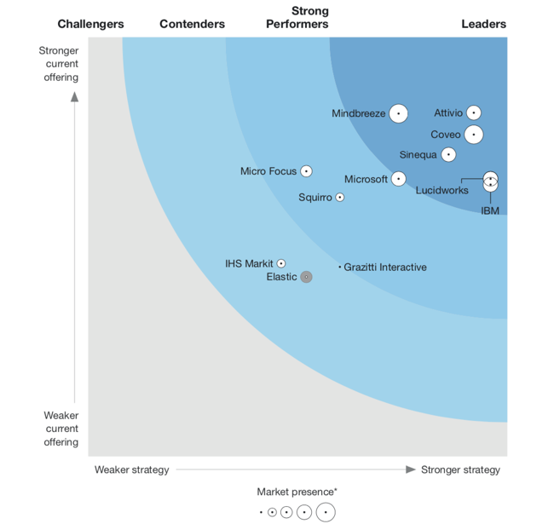
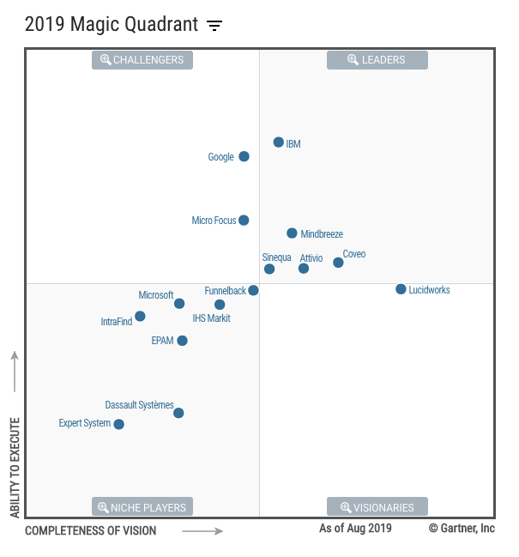

Market & Competition
Leader Forrester Wave Cognitive Search Q2 2019
Leader 2019 Magic Quadrant for Insight Engines
Insight Engine Focused Competitors
Major Cloud Players
Azure Cognitive Search & QnA Maker
Google Cloud Search & AutoML NL
Amazon Kendra, Textract
IBM Cloud and Cognitive Software Fast Start 2020

Slide 14








What makes Watson Discovery different?
Major Cloud Providers
Insight Engine Providers
Deploy Anywhere
Utilize Watson Discovery wherever necessary to serve up answers from knowledge bases
Only available within a single cloud environment
Cloud Native Solution
Completely cloud managed, spin up and be functional in less than an hour
On-prem products adapted to the cloud
End-to-end Functionality
From data ingestion to query that doesn’t require chaining together of multiple APIs
Significant development effort needed to combine services
Performance & Security
Storage and Compute Isolation with Premium plans & on-premise option
Lack complete compliance roadmap and support
Advanced Customization
Domain adaptation, Relevancy training and Document understanding
Limited customizability, mostly function on data that has limited applicability
Out-of-box AI functions
Natural language queries, relevancy training, passage retrieval, anomaly detection, and more.
Minimal expertise and research in NLP
Training with Admin UI
Allows business users to train and improve results without developer expertise
Built for developers with familiarity with overall ecosystem
Smart Document Understanding
Teach Discovery to deeply under-stand structure of complex documents in minutes
No way to deal with complex documents
IBM Cloud and Cognitive Software Fast Start 2020

Slide 15
Demos and What’s New

Slide 16
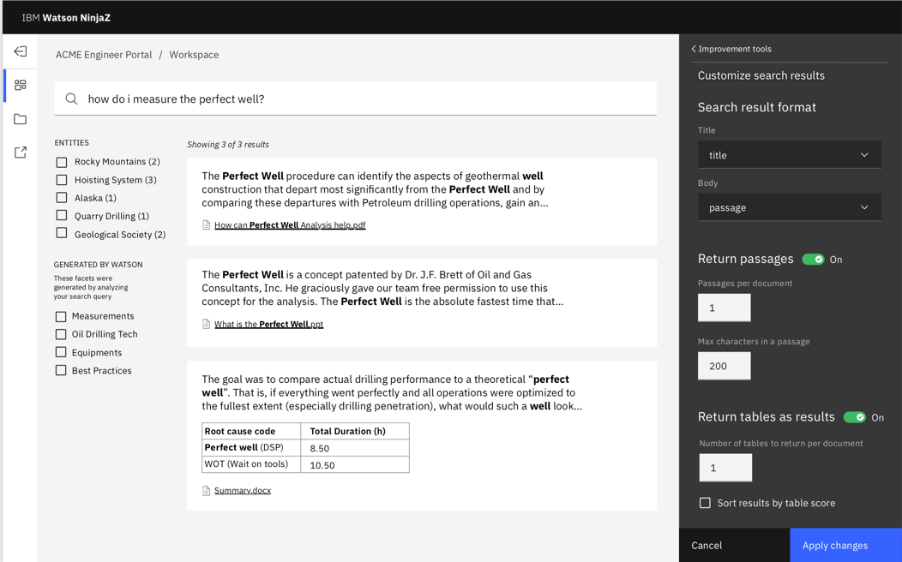
Redesigned User Experience
New guided experience for configuring Discovery projects
Watson will provide a series of recommendations to improve the relevancy and display quality of Discovery results
Optimized by use-case “Projects”
IBM Cloud and Cognitive Software Fast Start 2020

Slide 17
More Built-in Natural Language Processing
Discovery now ships with out-of-the-box models from Watson Natural Language Understanding:
Keyword
Entities
Document Sentiment (most languages)
In addition to advanced NLP customization:
WKS Custom Models
WKS Advanced Rules Models
CA Studio Models
Dictionary and Character Pattern Annotators
IBM Cloud and Cognitive Software Fast Start 2020

Slide 18
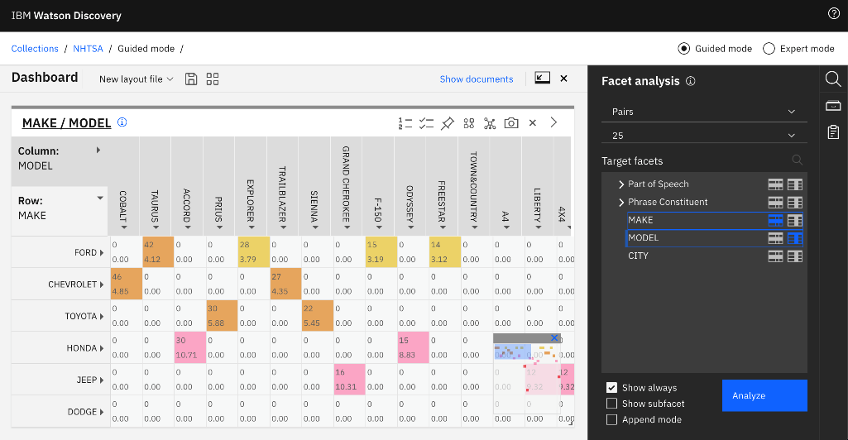
Content Mining on Watson Discovery
Bringing Content Mining capabilities from WEX to Watson Discovery
End user interface to explore data sets and uncover hidden insights using deep analytics techniques
Simplified setup flow to get non-technical users started more quickly
Allows for advanced customer care analytics use cases:
Deeper insights in Voice of the Customer
Root cause analysis for product issues
Analyze effectiveness of sales and marketing
IBM Cloud and Cognitive Software Fast Start 2020

Slide 19
Demo
Handle common questions and tasks with explicit responses
Notes:
angel

Slide 20
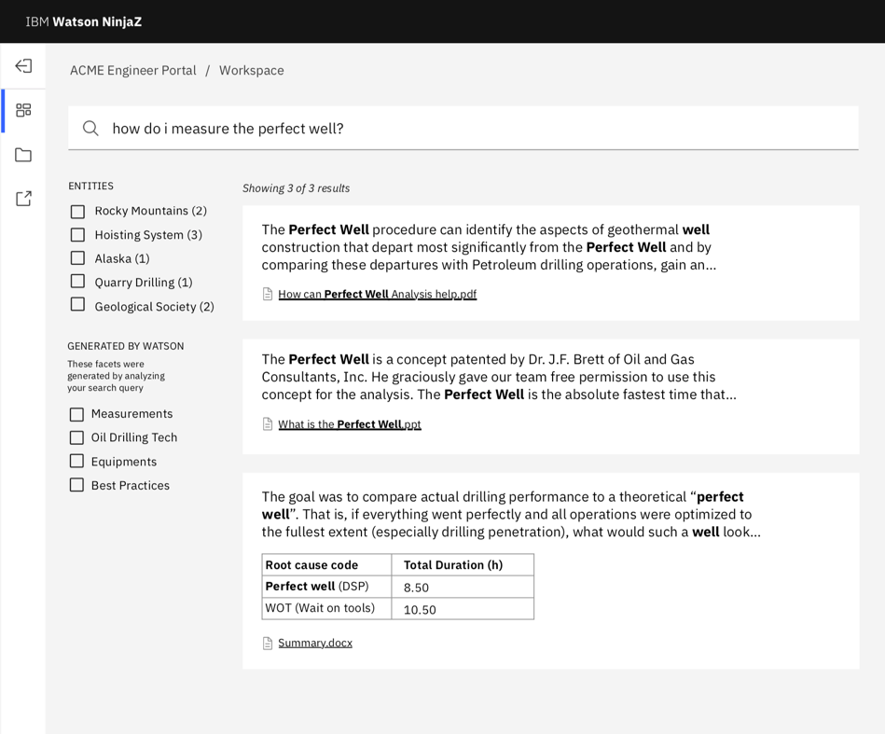
Dynamic Facets
Automatically identify a relevant set of terms of “facets” to help users formulate more effective queries
User unsupervised learning from unstructured text content rather than requiring structured values like traditional facets
Enables a user to:
Efficiently explore the corpus for content relevant to the business problem
Follow a guided experience to quickly narrow searches to relevant results in the corpus
IBM Cloud and Cognitive Software Fast Start 2020

Slide 21
Demo
Handle common questions and tasks with explicit responses
Notes:
angel

Slide 22
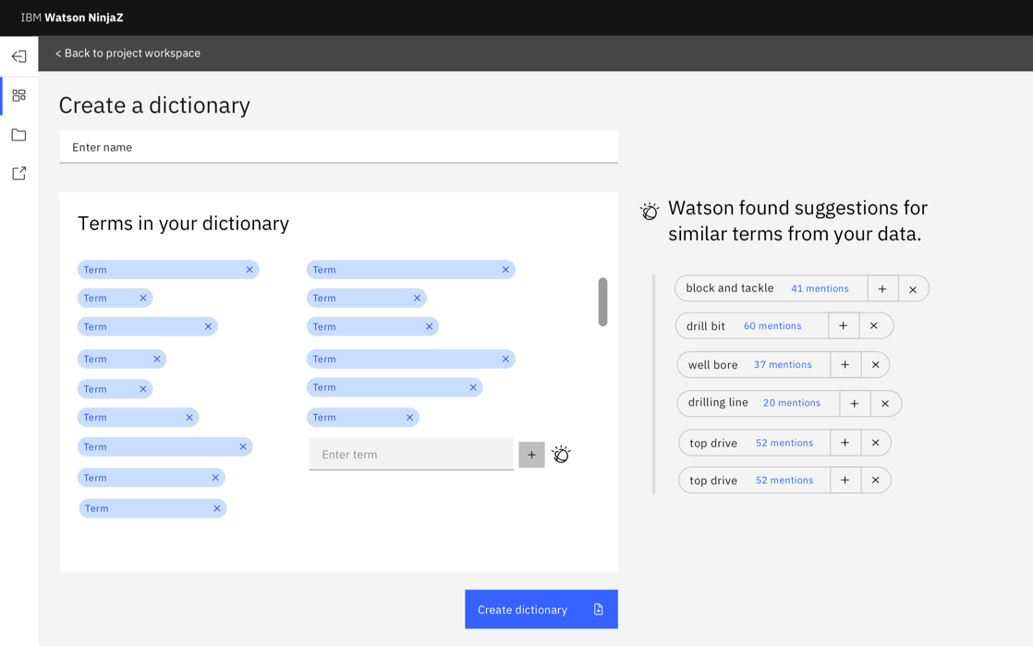
Rapid Model Development
Build custom models for use as annotations/facets quickly
Create inside of Discovery very quickly
Requires no additional software – using knowledge that exists in your corpus
IBM Cloud and Cognitive Software Fast Start 2020

Slide 23
Demo
Handle common questions and tasks with explicit responses
Notes:
angel

Slide 24
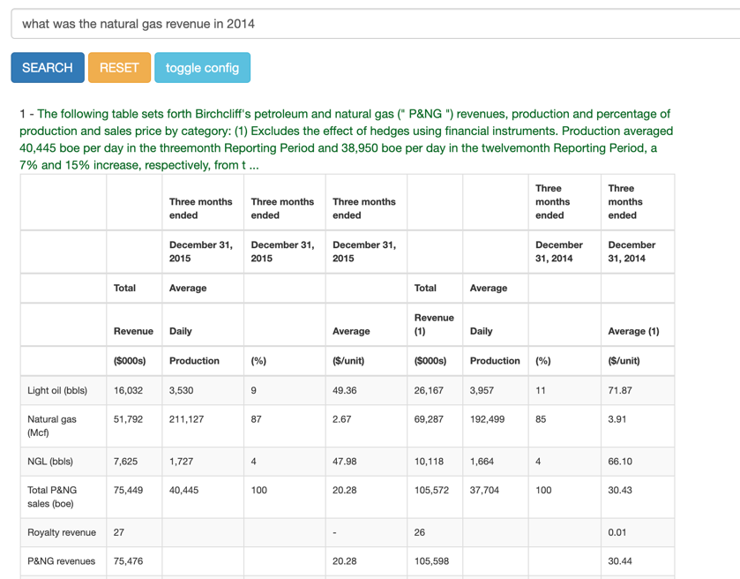
OOB Table Identification and Retrieval
Identify tables that contain answers to a user’s natural language query
Leverages out-of-the-box and trained table extraction and table structure to find most relevant tables
Enables a user to:
Find answers in previously hidden or difficult to evaluate content
Get results in the context of the original source to provide stronger evidence
IBM Cloud and Cognitive Software Fast Start 2020

Slide 25
Demo
Handle common questions and tasks with explicit responses
Notes:
angel

Slide 26
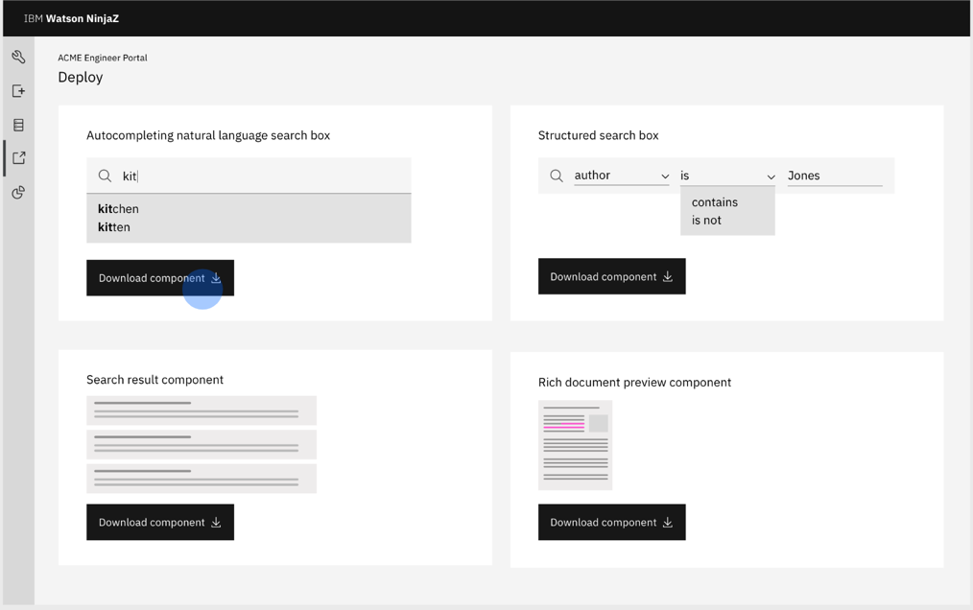
Reusable Components
Accelerate application with a set of UI components that can be easily embedded into a customer application
Enable rapid time to value by providing most common and valuable functionality out of the box
Initial components planned:
Document preview – see results in the context of the source document to provide more reliable evidence
Search with autocomplete – enable improved query formulation with autocomplete and parameter selection
Results with facets – highlight relevant responses and provide intelligent methods to filter responses
IBM Cloud and Cognitive Software Fast Start 2020

Slide 27
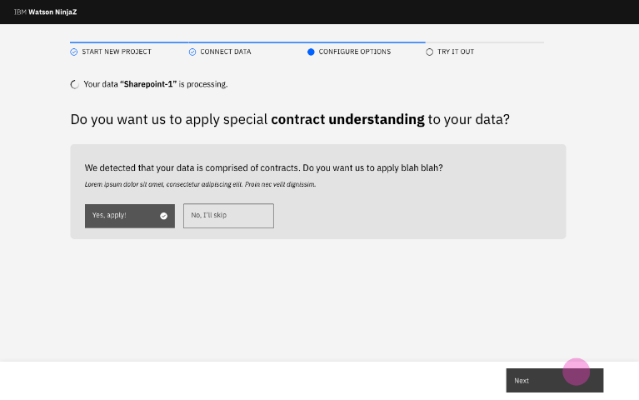
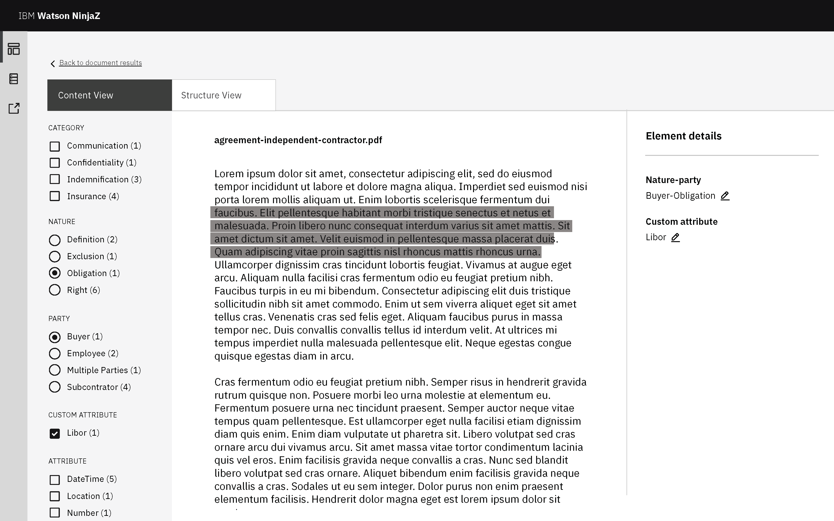
Out-of-the-Box Domain Intelligence for Watson Discovery (optional add-on)
Out of the box domain intelligence for contracts, purchase orders and invoices.
Applies NLP specific to domains, enabling use cases like business process automation, governing document review and analysis
and more
Document visualizer users to dig deep down into parts of documents, zooming them into
a document level search and exploration
Models can be customized and adapted to client’s domain
IBM Cloud and Cognitive Software Fast Start 2020

Slide 28
Roadmap

Slide 29
Increased Language Support Q4 2019
Group A (already supported)
Arabic
Japanese
Dutch
Chinese Simplified
Chinese Traditional
English
Portuguese (BR)
Italian
German
Korean
Spanish
French
Russian
Czech
Polish
Romanian
Slovak
Group B (planned 2020 support)
Hebrew, Swedish, Finnish, Danish, Norwegian (Brokmal, Nyrosk), Malay, Thai
Notes:
Master Draft 1
Master Draft 1
29
angel

Slide 30
Our Vision
Business problem
We must anticipate the future of the end user experience for customer service. "Chat only" does not appear to be a winning recipe. What would the best experience be?
Solution
"Efficiency and engagement must be balanced". In other words, getting the job done as quickly as possible would not be enough over time, the experience should be delightful and strengthen the user's attachment to the brand that provided the assistant.
Enable business users to multiply their productivity by delivering unencumbered access to answers from complex business content
Notes:
Bring AI up the stack to business users
angel

Slide 31
Public Cloud Parity
Cloud first development – 90% of CP4D features
1H 2020: Premium Public Cloud
1H 2020: Multi-tenant Cloud
IBM Cloud and Cognitive Software Fast Start 2020

Slide 32
Reading Comprehension
Pinpoint answers within a body of text to get to more specific results
Leverages deep learning to understand the text and find the most relevant answer
Enables a user to:
Find specific answers without needing to comb through a complete passage or portion
of text
Get results more directly targeted to the
user natural language questions
IBM Cloud and Cognitive Software Fast Start 2020

Slide 33
Demo
Handle common questions and tasks with explicit responses
Notes:
angel

Slide 34



Real-time NLP API
Analyze the output of individual documents from the Watson Discovery NLP pipeline
Clients can store documents in their own database or data lake for further analytics/processing
Feed output of Watson Discovery into a business automation
Ingest API
Files
Smart Document Understanding
NLP Customization
Individual doc analysis
Real-time NLP API
oneNLP Stack
IBM Cloud and Cognitive Software Fast Start 2020

Slide 35
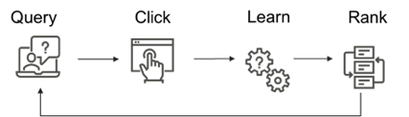
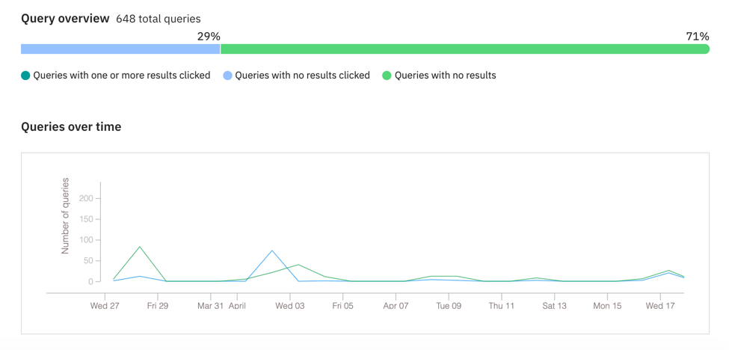
Continuous Learning on CP4D
Semantic Match boosts relevancy out-of-the-box with no training
Discovery results improve automatically without manual training using continuous learning
Click, vote or other feedback data from users acts as signals for Discovery to know what answers are right and wrong
Model automatically runs when enough data has been gathered, reducing maintenance and
tuning of system
Planned Improvements
Reduced training times
IBM Cloud and Cognitive Software Fast Start 2020

Slide 36



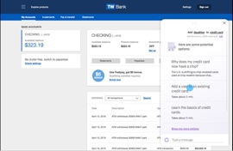
Contact Center Analytics
Leverage multiple AI capabilities to analyze data generated in contact centers and find valuable patterns, trends, insights
Customizable speech to text for transcription
Customizable language modeling with WKS and enrichments
Explorations and deeper analysis using Content Miner
Combine with Assistant to take action
IBM Cloud and Cognitive Software Fast Start 2020

Slide 37
What About WEX?

Slide 38
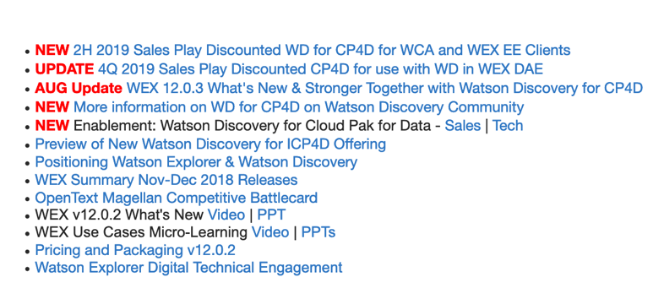
What do Watson Explorer clients need to know about Watson Discovery 2.1.1?
Builds on Watson Explorer: based on the oneWEX architecture at its core
Visit ZACS for access to Sales Plays for WEX customers
ZACS Link
Content Mining is now available: with its own project type and enhanced usability
Over 90% of oneWEX features are now available
Offers rich set of major new features to Watson Explorer users: SDU, Table Understanding, Content Intelligence
Watson Explorer will be supported for multiple years to come
Watson Discovery 2.1.1 is included in Watson Explorer Deep Analytics Edition 12.0.3.x: use is limited to 10 million documents and client must or purchase CP4D
Watson Explorer is now restricted for sale to existing clients
IBM Cloud and Cognitive Software Fast Start 2020

Slide 39
Check Out Session
Tomorrow:
Jeff Sumner
Tomorrow
IBM Cloud and Cognitive Software Fast Start 2020

Slide 40
Pricing and Sizing

Slide 41
Bundle Parts
Part | Metric | Rules | Explanation | Committed Term License |  | Perpetual + 12mo S&S
 |  |  |  | Part | List Price | Part | List Price
Base | 40 VPCs | Must purchase one for each customer | This is the required minimum configuration | D26BXLL | $19,200 | D26BULL | $576,000
Documents | RVU 1 Resource = 100,000 Documents | Must purchase one for each customer Requires Base | 1 RVU for 100,000 documents is the required minimum configuration. Additional quantity is optional and recommended based on customer use case | D26DPLL | $4,000 | D234XLL | $120,000
Additional Capacity | 8 VPCs | Requires Base to be purchased | Additional quantity is optional and is recommended based on customer requirements like number of documents and system throughput | D26CBLL | $1,174 | D2362LL | $35,200
Content Intelligence | Install | Requires Base and Documents | Optional but necessary to unlock and enable use of Content Intelligence features | D26CSLL | $6,667 | D26CPLL | $200,000
Notes:
angel

Slide 42
Document Quantity RVU
Documents | Resources | RVUs
100,000 | 1 | 1
200,000 | 2 | 2
300,000 | 3 | 3
400,000 | 4 | 4
500,000 | 5 | 5
600,000 | 6 | 6
700,000 | 7 | 6
800,000 | 8 | 7
900,000 | 9 | 7
1,000,000 | 10 | 8
10,000,000 | 100 | 27
20,000,000 | 200 | 31
100,000,000 | 1000 | 53
Step-by-Step Guide
Determine the number of documents to be processed by the system
Determine total number of resources required by dividing the number of documents by 100,000
Use the Value Unit Converter/VUE 164 table to determine quantity of RVUs (or reference cheat sheet to left)
Multiply out RVU quantity by the document part list price (bundle, add-on prod or add-on non-prod)
Include this document quantity and price in your quote which must also include the base part (24 VPCs)
Example
For an agent assist use case a customer has content collections with up to 1 million documents
10 Resources are required (1 million documents / 100,000)
8 RVUs are required after consulting cheat sheet or putting 10 Resources into VUE 164 calculator)
8 RVUs * $192K = $1,536,000
Include this 8 RVU quantity in your overall quote which must also include the base part (24 VPCs)
Pricing Calculator
A pricing worksheet for basic configuration is available at: Watson Discovery Sales Kit
Notes:
angel

Slide 43
Pricing Examples
 | PoC | Content Mining | Large Corpus
Scenario | A client is implementing a chatbot with longtail question support. They anticipate 10,000 users per month and they need to process 20,000 documents, with two queries per second, for the long tail support. | A client is transforming their call center operations to provide Agents with chatbot and and expert assist capabilities to eliminate manual research and speed customer problem resolution. Their agent assist search solution will serve 1000 agents at 5 queries per second to quickly locate answers in complex content represented by about 1 million documents. | A client is implementing a large expert assist search solution to speed the collection and verification of documents from complex content sources to speed the collections and presentation of evidence to industry regulators. 1700 users will be accessing 10 million documents from sources such as database, Box, Sharepoint and fileshares. SDU will be used extensively with a collection of complex content about medical devices.
Base | Quantity 1 (40 VPC) $576,000 | Quantity 1 (40 VPC) $576,000 | Quantity 1 (40 VPC) $576,000
Documents | Quantity 1 RVU (100K documents) $120,000 | Quantity 8 (10 Resources) $960,000 | Quantity 27 (100 Resources) $3,240,000
Additional Capacity | n/a | Quantity 2 (8 VPC) for throughput $70,400 | Quantity 7 (8 VPC) for throughput $246,400
Total List | $696,000 ($208,800 @70% discount) | $1,606,400 ($481,920 @70% discount) | $4,062,000 ($1,218,600 @70% discount)
Notes:
John

Slide 44
#FastStart2020
Q&A
IBM Cloud and Cognitive Software Fast Start 2020

Slide 45
IBM Cloud and Cognitive Software Fast Start 2020 Session 22
Please give us your feedback – Access the survey link at the bottom of the session details in the mobile app Angel Montesdeoca Offering Manager, Watson Discovery Angel@ibm.com John Pecorari Offering Manager,Watson Discovery jpecorari@us.ibm.com
#FastStart2020

Slide 46
Check-in Code = 78e9 Access the check-in link at the bottom of the session details in the mobile app.

